Slide 1

Preflight Check List
Everyone:
Sign into our Zoom meeting through our integrated Blackboard/Zoom link
Make sure that you can hear the conversation, see shared desktops, and view group chat topics
You will need a headset with a microphone to be able to effectively listen and speak
You will need to be able to share your computer screen
Thank you if you choose to leave your camera on to help make our class more interactive
In person participants also:
Make sure that your microphone and speakers are muted/off so that we don’t get an echo
Sit in a good spot near the classroom ceiling microphones if possible
Start Recording

Slide 2
Agenda:
Prework and Announcement
Programming Languages, Libraries, & Platforms
Docker Overview
Scrum Team Review of React, Docker, and Go
Perspectives and Priorities
Quiz 5
Prework for Next Class
Discussion & Questions welcome at any time but please be present with no phones or email during our time together

Slide 3
Prework For Next Class
Complete through activity 10 prior to next class
Be prepared for a scrum team discussion on React, Docker, and Go
Be prepared for Quiz 5

Slide 4
Programming Languages & Platforms

Slide 5
Programming Languages, Libraries, &Platforms
Often the platform is more impactful than the language when considering software architectures:
Platform Requirements:
Local, regional, or global product scope
Deployment and update mechanisms including hosting & distribution (operating system, client, server, Internet, embedded, etc.)
Security
Development team (skills, distribution, process, etc.)
Language, Libraries, and Platforms:
C++ with Microsoft Foundation Classes for Windows
C++ with Gt for embedded
Go with Google Cloud Functions for the Web
Go with Docker for the Internet
JavaScript with React Native for Android

Slide 6
Docker Overview

Slide 7
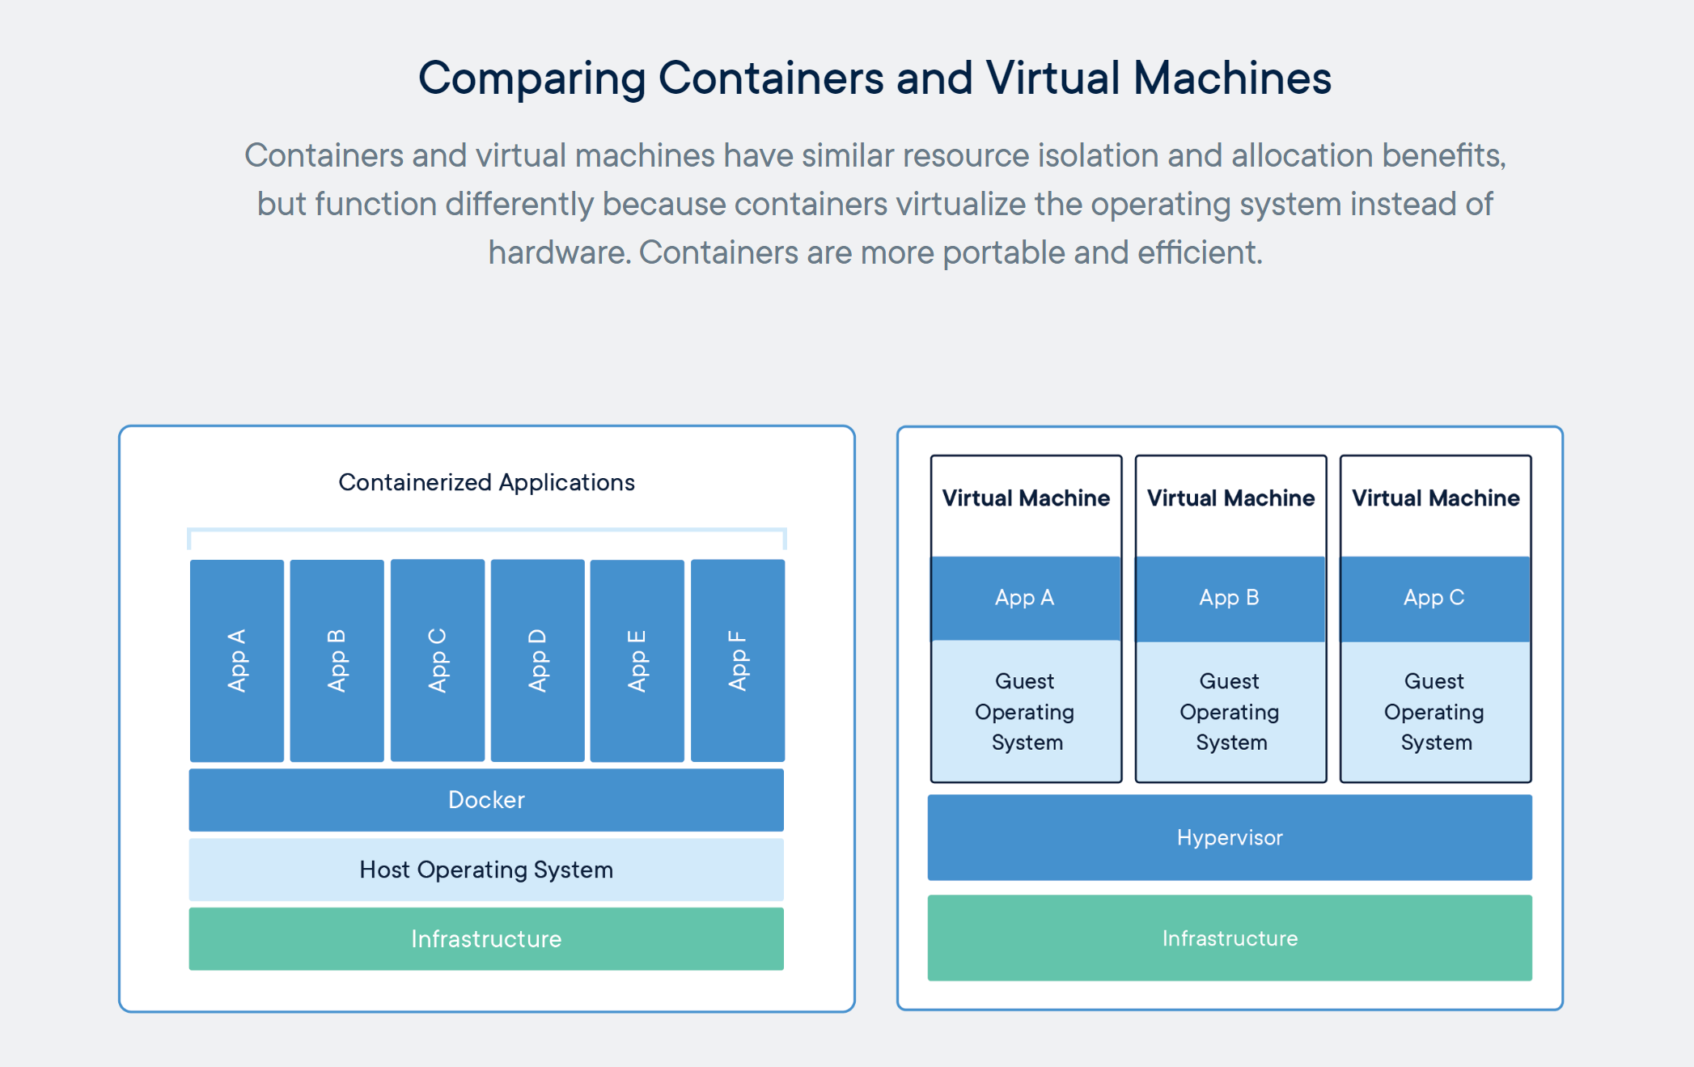
Containers & Docker [link]

Slide 8
Kubernetes & Swarm [link]

Slide 9
Scrum Team Review of React, Docker, and Go
Assign presenter
Team reviews key topics using “team number by percent of content” method
Team sits back, relaxes, and acknowledges the bravery and dedication of the presenter
Sections:
React
Docker
Go
Azure (or other cloud provider)
Question:
How could each team elegantly fit these Languages and Platform technologies into your final projects?

Slide 10
Perspectives & Priorities
Process:
Waterfall
Iterative
Agile
CMMI and ISO
Technology:
Architecture & Design,
Languages, Tools, and Platforms
Customer (User):
Epics, Features, Stories

Slide 11
Recall Perspectives & Priorities
Agile Priorities:
Customer
Technology
Process

Slide 12
Final Project Proposal Perspectives & Priorities
Final Project Proposals:
Customer
Technology (platform, library, and language)
Process

Slide 13
Quiz 5

Slide 14
Prework
Everything is due Sunday!
How should we spend our valuable time Thursday?

Slide 15
End of Session

